Slide 1
Text Analytics Final Project: Unveiling Insights from Tweets
This project delves into the world of Twitter data. We analyze tweets using advanced text analytics techniques to uncover trends, sentiments, and topics. Through this exploration, we aim to gain valuable insights into public opinion and social dynamics.
Submitted By:
Aditi Joshi - 37
Adwait Gosavi – 38 https://github.com/adwait005
Garima Bhatia – 47 https://github.com/Garimabhatia06
Goutam Jain - 48
Shruti Kothare – 70 https://github.com/ShrutIKOTHARE
Mahvish Khan – 83 https://github.com/welingkarcoders

Slide 2
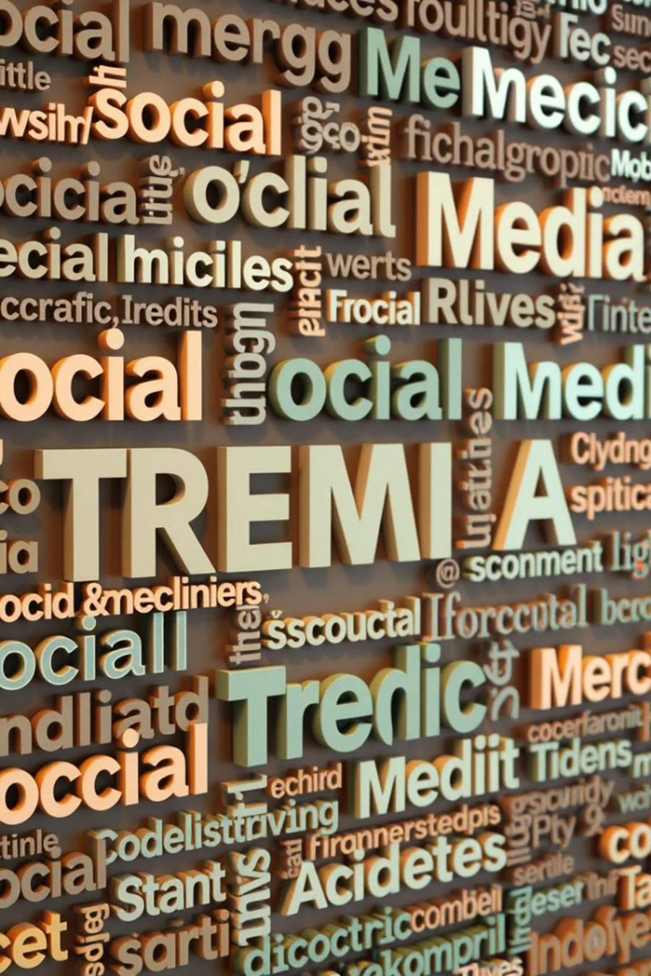
Data Acquisition and Preprocessing
The twitter sentiment data was selected for the sentiment analysis.
The data was preprocessed
Removed the stop words
Removed non-alphabetic characters
Converted it to lowercase
Performed Lemmatization on the cleaned text

Slide 3
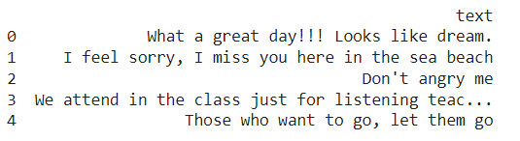
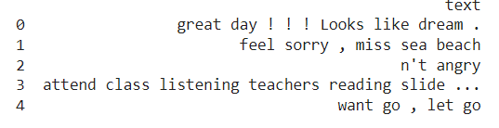
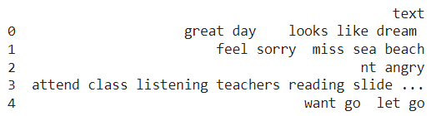
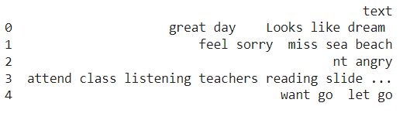

Slide 4
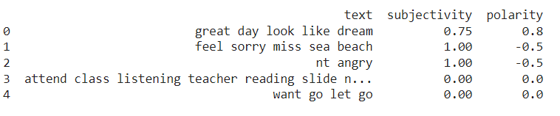
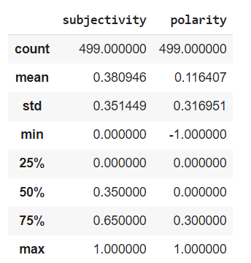
Subjectivity and Polarity
Subjectivity: This measures whether a text expresses personal opinions, emotions, or factual information. It ranges from 0 to 1
A score closer to 0 indicates the text is objective, presenting facts without personal feelings.
A score closer to 1 indicates the text is subjective, where personal opinions, emotions, or judgments are expressed.
Polarity: This refers to the sentiment or emotional tone of the text. It also ranges from -1 to 1
A score of -1 indicates negative sentiment.
A score of 0 indicates neutral sentiment.
A score of 1 indicates positive sentiment.

Slide 5
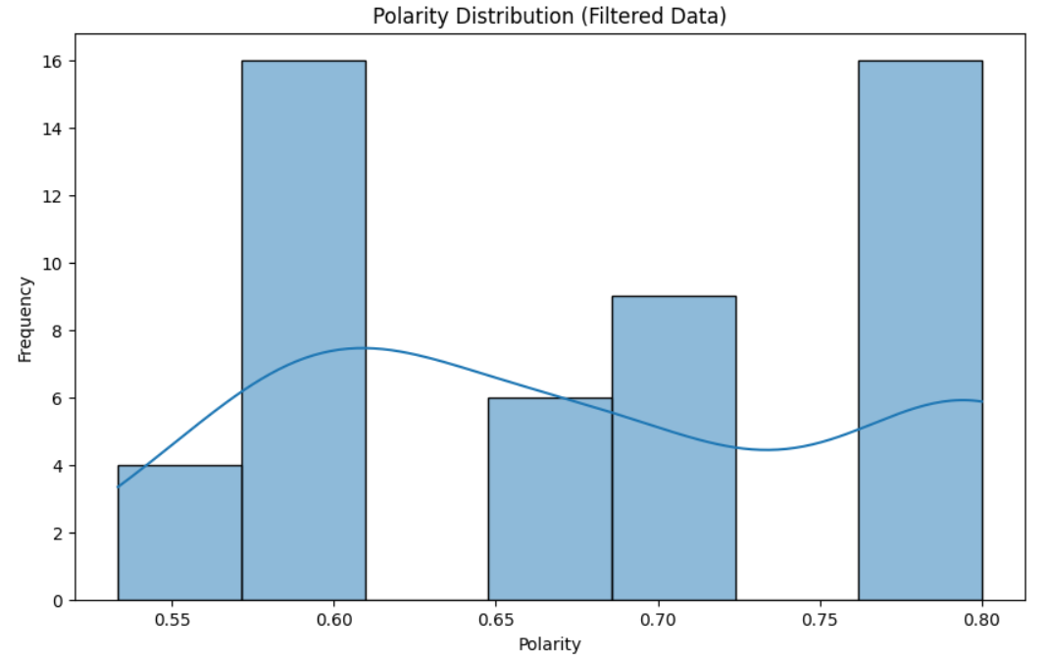
Polarity Distribution

Slide 6
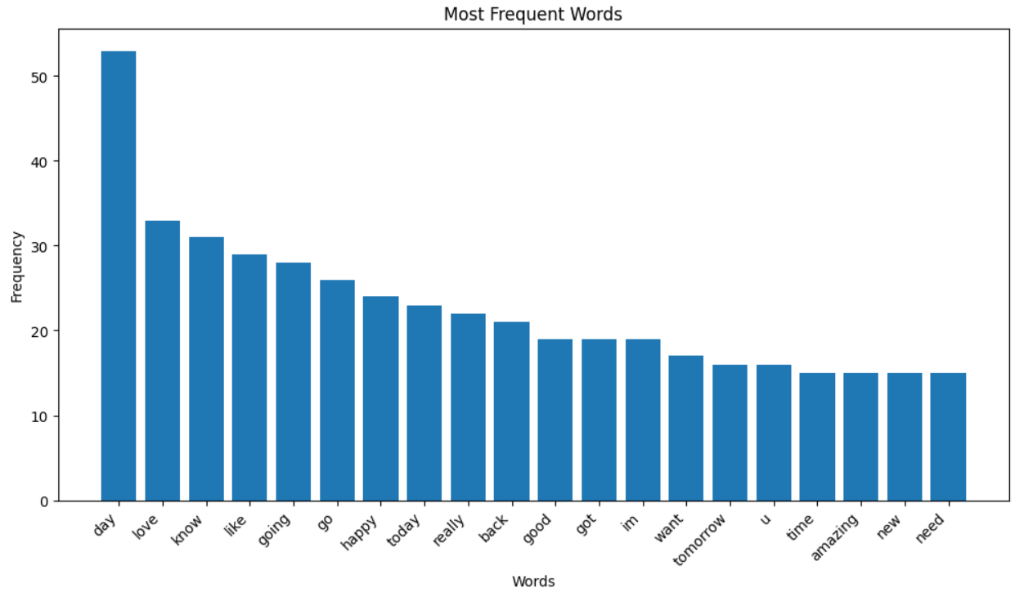
Most Frequent Words in the text

Slide 7
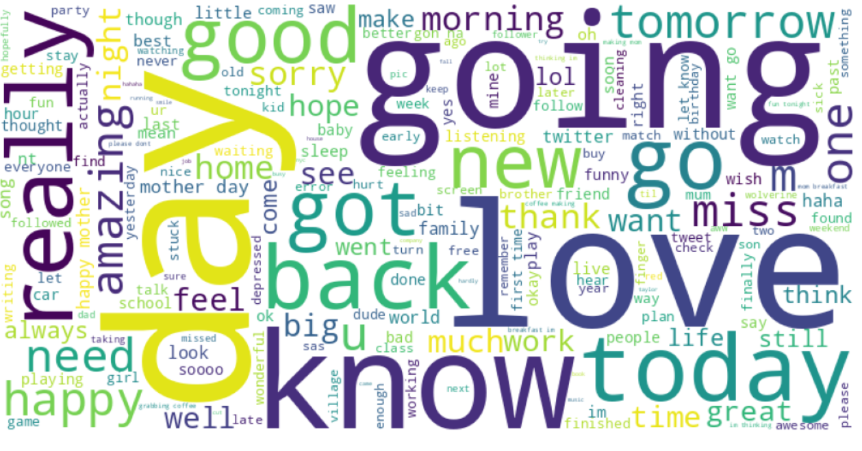
Word Cloud

Slide 8
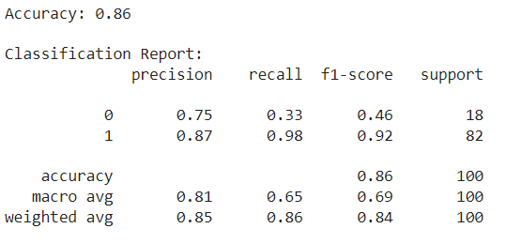
Random Forest Model
The accuracy of the model is 86%
The precision for the negatives (0) is 75%.
The precisions for the positives (1) is 87%

Slide 9
Thank You

